Slide 1
Tentcraft Employee and Inventory Information
Richard Robertson

Slide 2


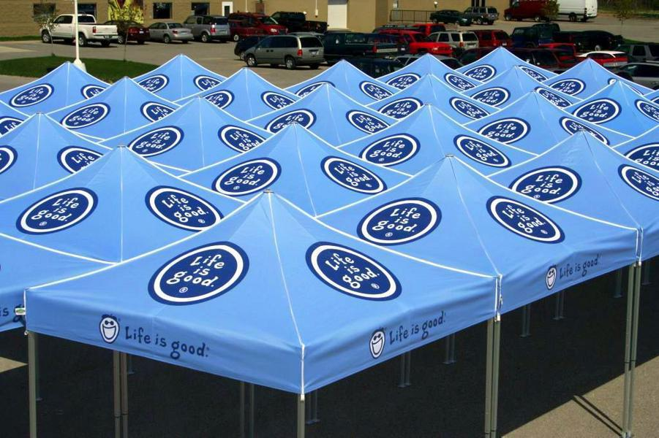
Audience
Make It Better

Slide 3
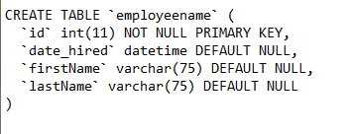
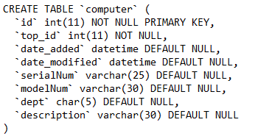
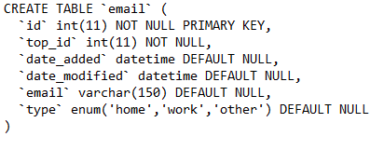
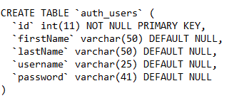
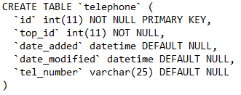
SQL Tables

Slide 4
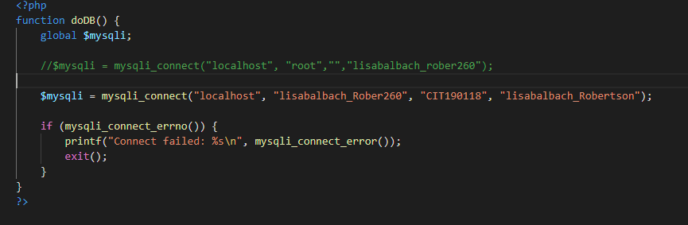
Connect to Database

Slide 5
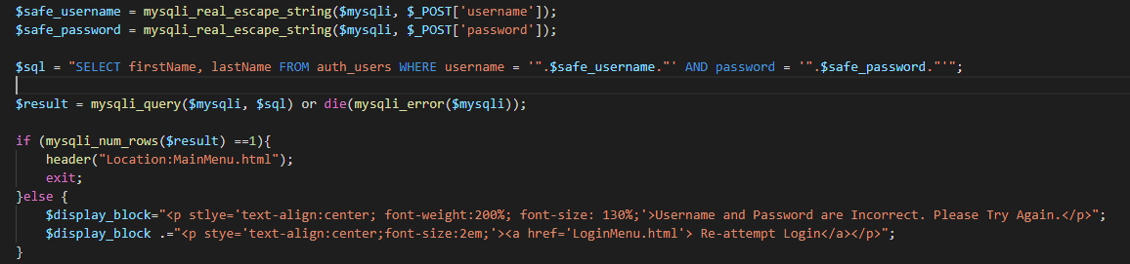
login

Slide 6
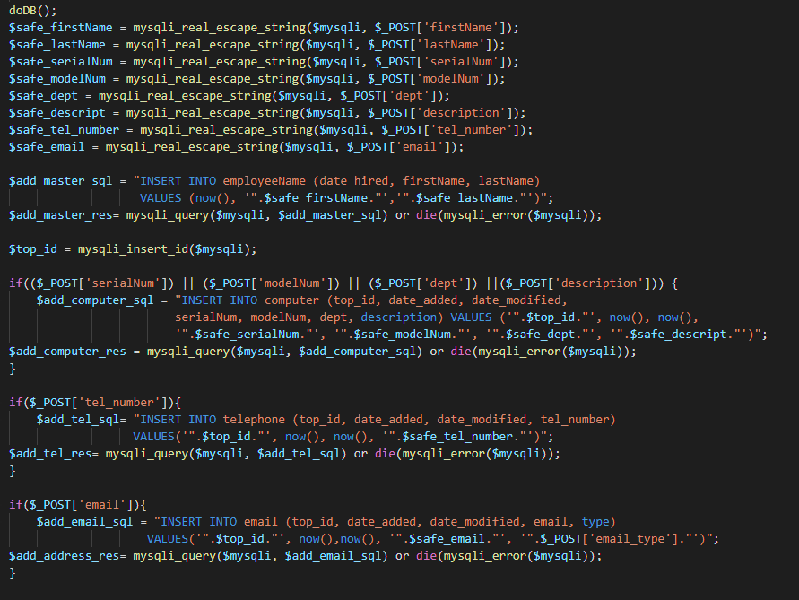
Adding an entry

Slide 7
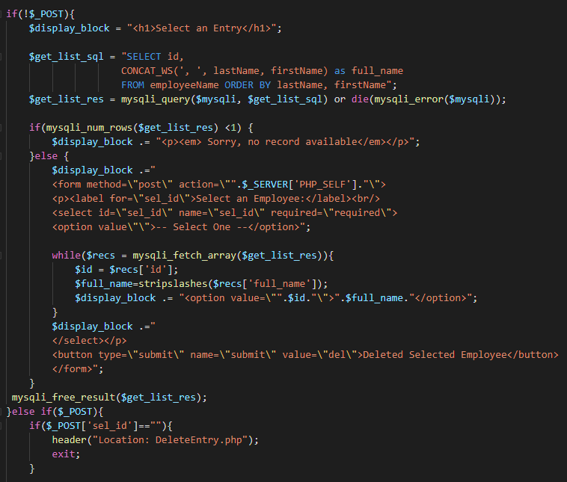
Deleting an Entry

Slide 8
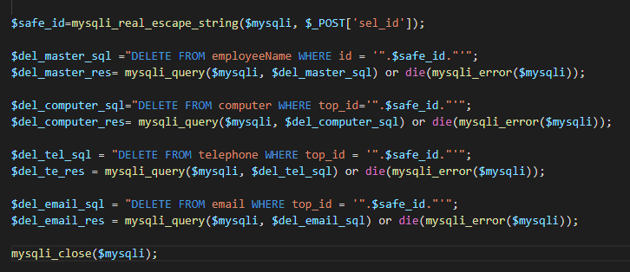
Deleting an Entry

Slide 9
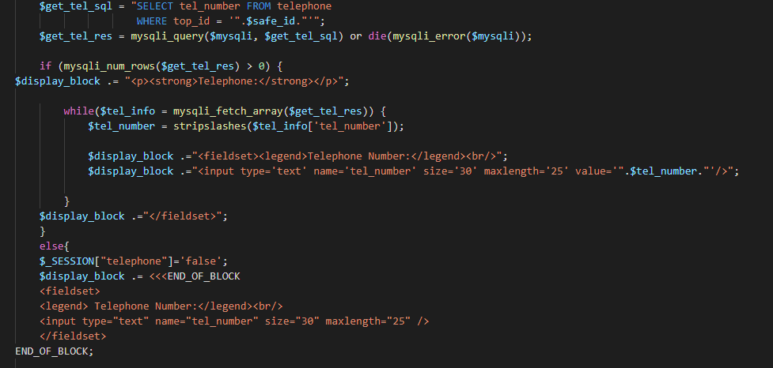
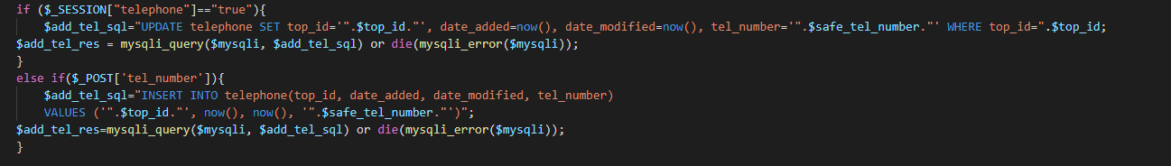
Update an Entry

Slide 10
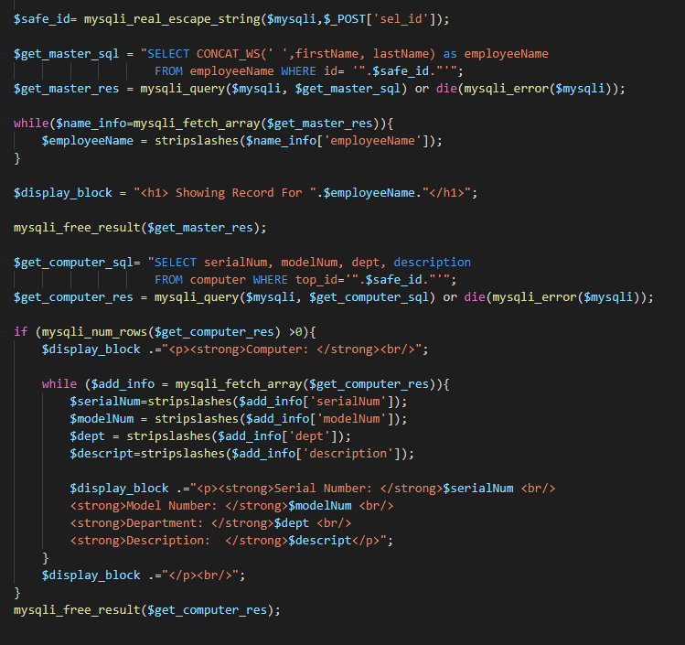
Select and View Entry

Slide 11
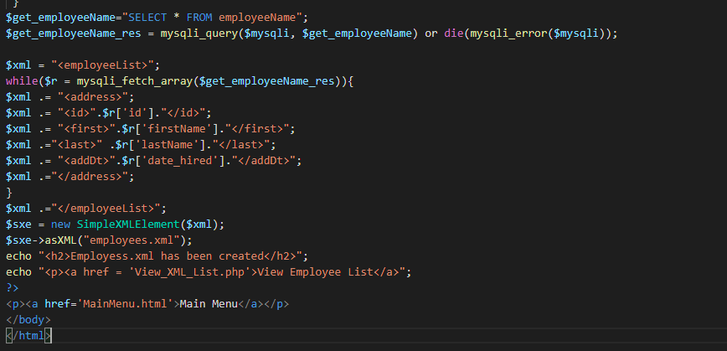
Writing XML

Slide 12
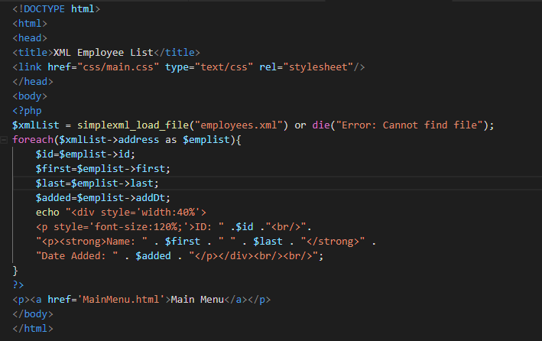
Viewing XML

Slide 13
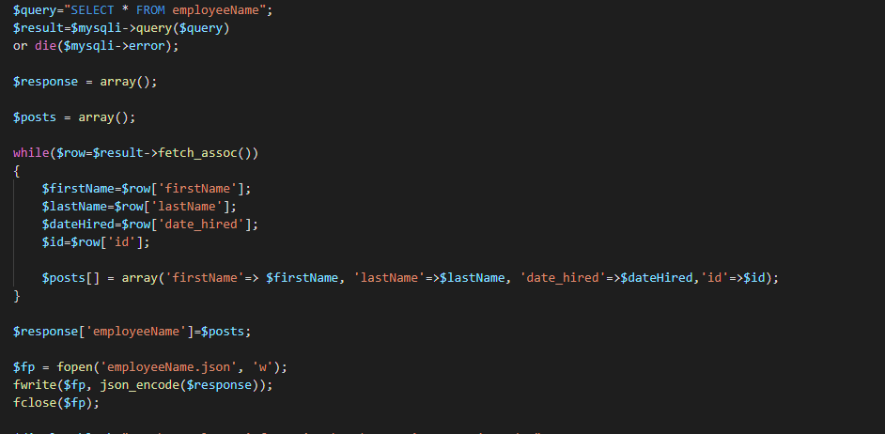
Writing Json

Slide 14
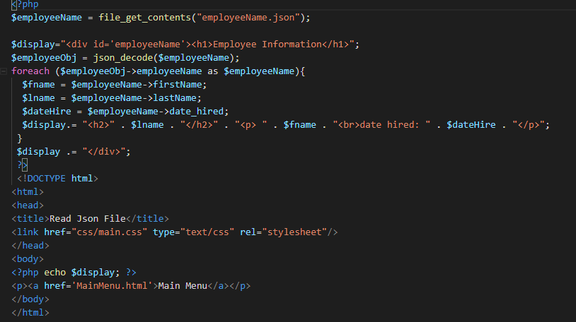
Viewing Json

Slide 15
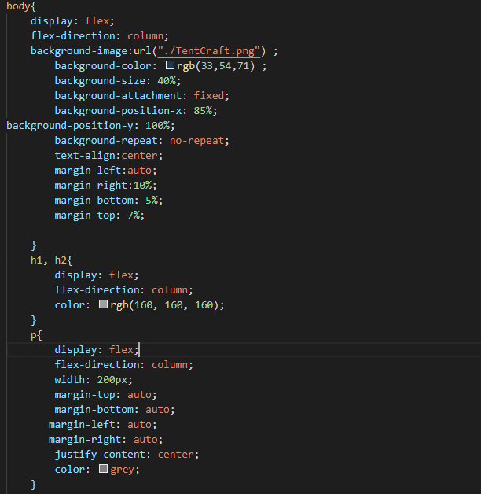
CSS Styling

Slide 16
Learning
PHP is a great tool to verify and validate information
PHP helps to bring what we learned wit SQL to front-end
Problems
Punctuation and Syntax

Slide 17
Thank you for listening!
Questions?

